Slide 1

Dr. AMBEDKAR INSTITUTE OF TECHNOLOGY
(An Autonomous Institute Affiliated to Visvesvaraya Technological University, Belagavi, Accredited by NAAC, with ‘A’ Grade)
Near Jnana Bharathi Campus, Bengaluru – 560056
2023-24
DEPARTMENT OF ELECTRONICS AND COMMUNICATION ENGINEERING
Subject: PYTHON PROGRAMMING [21ECT6043]
Semester: 6
Group Activity
On
“CLI Based Chat tool”
Under the Guidance of:
Dr.GIRIJA S, Electronics and Communication Department
Name: Dhanapal K USN: 1DA21EC045
Name: Durgesh F C USN:1DA21EC050
Name: K Gurubasavaraj USN:1DA21EC066

Slide 2
Contents
Aim
Algorithm
Code with proper explanation
Execution
Outcomes and applications

Slide 3
AIM:
To build a simple command-line chat tool which is easy to use and also has a very minimal interface.
OBJECTIVE:
Building a chat tool with a simple command-line interface which supports multiple chat rooms.
CONTEXT:
Most often than not, we run heavy GUI-based applications for the simplest of tasks. One such simple task is instant messaging or chatting. Chat tools enable users to start chatting with other users in real-time. It also enables users to transmit text messages, images, videos, and hyperlinks.

Slide 4
Algorithm for server and client
SERVER:
Initialize Server
Wait for client connection
Communication loop
-Receive data from the client
-Check if data starts with “FILE”
- If the data does not start with "FILE", treat it as a text message and print it.
-Prompt the server user for a response message.
-Send the response message to the client.
4. Close the connection

Slide 5
Algorithm for server and client
CLIENT:
Initialize Client
Communication loop
-Prompt the client user for input.
-Check if the input starts with "SEND“
- If the input does not start with "SEND", treat it as a text message and send it to the server.
-Receive and print any response message from the server.
4. Close the connection

Slide 6
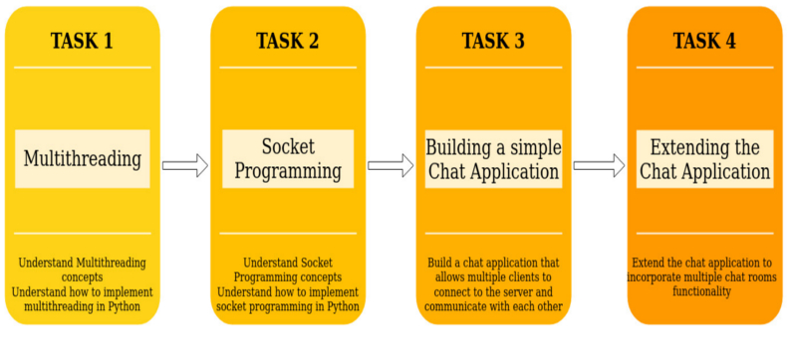
Outcomes

Slide 7
Outcomes
Chat tool with multiple room functionality.
The clients should be able to do the following
List all the existing chat rooms.
Create a new chat room.
Join an existing chat room.
Messages in sent by a client in a chat room should be only broadcasted to same chat room.
Multiple chat rooms should be able to function at the same time.
Each chat room should allow communication between multiple clients.

Slide 8
Applications
Local Network Chat Application
File Transfer Utility
Educational Tool
Prototype for Messaging Applications
Internal Communication System
Remote Assistance Tool
Data Transfer for IoT Devices
Peer-to-Peer Communication
Local Collaborative Projects
Secure Private Communication

